Slide 1
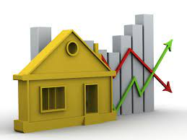
House price prediction
Prateek kumar singh - 21SCSE1010884
ADITYA PRAJAPATI - 21SCSE1420051
MD. RIZWAN AHMAD - 21SCSE1010811
Nitesh kumar - 21SCSE1010954

Slide 2





Outline
Tools Used
How It Works ?
What it Does ?
Project Summary
Technology Used

Slide 3
Introduction
► Problems faced during buying a house:
Buying a house is a stressful thing.
Buyers are generally not aware of factors that influence the house prices.
Many problems are faced during buying a house.
Hence real estate agents are trusted with the communication between buyers and sellers as well as laying down a legal contract for the transfer. This just creates a middle man and increases the cost of houses.

Slide 4
► They believe that it depends upon:
1) The square foot area
2) Neighbourhood
3) The no. of bedrooms
But it depends upon many factors also.....Such as:
1) No. of storeys.
2) Area outside the house.
3) Rooms on one floor.

Slide 5
Project Summary
Our project is a machine learning app, based on certain specifications of your future home it will try to guess the most accurate price.
Information such as state, city, area, stores.

Slide 6
Technology used
1. Machine Learning →
Tom Mitchell provides explained: "A computer program is said to learn from experience E with respect to some class of tasks T and performance measure P, if its performance at tasks in T, as measured by P, improves with experience E.“
Example: playing checkers.
E = the experience of playing many games of checkers
T = the task of playing checkers.
P = the probability that the program will win the next game.

Slide 7
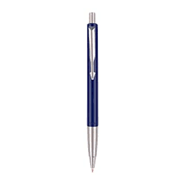
Example: predicting whether the given object is pen or pencil??
E = the experience of predicting many pens and pencil.
T = the task of predict pen or pencil
P = the probability that of whether it is a pen or pencil

Slide 8
In general, any machine learning problem can be assigned to one of two broad classifications:
Supervised learning and Unsupervised learning.
1) Supervised Learning: - In supervised learning, we are given a data set and already know what our correct output should look like, having the idea that there is a relationship between the input and the output. Supervised learning problems are categorized into "regression" and "classification" problems.
2) In a regression problem, we are trying to predict results within a continuous output, meaning that we are trying to map input variables to some continuous function.

Slide 9
3) In a classification problem, we are instead trying to predict results in a discrete output. In other words, we are trying to map input variables into discrete categories.
Unsupervised Learning :- Unsupervised learning allows us to approach problems with little or no idea what our results should look like. We can derive structure from data where we don't necessarily know the effect of the variables. We can derive this structure by clustering the data based on relationships among the variables in the data. With unsupervised learning there is no feedback based on the prediction results.

Slide 10
Tools used
PYTHON
TENSORFLOW
Android Studio

Slide 11
How it works ?
COLLECTING DATA: FIRST STEP WAS TO COLLECT DATA WE COLLECTED DATA FROM DIFFERENT SOURCES & MERGED THEM TOGETHER TO FORM OUR TRAINING DATA SET.
THEN WE TRAINED THE MODEL USING MACHINE LEARNIG ALGORITHM WHICH IN THIS CASE IS MULTIPLE LINEAR REGRESSION.
BASED ON THE GENERATED GRAPHS WE PREDICT THE COST OF THE HOUSE

Slide 12
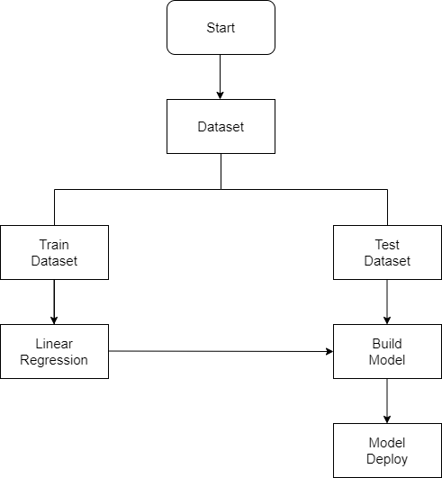

Slide 13
Future work
Our model had a low rmse score, but there is still room for improvement. In a real world scenario, we can use such a model to predict house prices. This model should check for new data, once in a month, and incorporate them to expand the dataset and produce better results.
We can try out other dimensionality reduction techniques like Univariate Feature Selection and Recursive feature elimination in the initial stages.
We can try out other advanced regression techniques, like Random Forest and Bayesian Ridge Algorithm, for prediction. Since the data is highly correlated, we should also try Elastic Net regression technique.

Slide 14
THANK YOU

